Slide 1
Technical Development regarding Observations in Basque Country and ERA5-Land

Slide 2
Heatwaves- Alerts and Thresholds definitions in Basque Country
Basque Country
Heat wave definition is based on thresholds regarding MAXIMUM DAILY TEMPERATURES & MINIMUM DAILY TEMPERATURES during a consecutive period of n days” (see table) (see table, according to the different climatic zones)
Zone | Station | Time serie | LON | LAT
Coastal Zone | Donostia Igueldo | from 1986 to 2016 | -2,0409 | 43,30631
 | Hondarribia Malkarroa | from 1986 to 2016 | -1,8509 | 43,31406
 | Punta Galea | from 2005-feb to 2016 | -3,0217 | 43,37493
 | Machichaco | Not availavle data-temp | -2,7528 | 43,45393
 | Lekeito | from 1997 to 2016 | -2,5103 | 43,37693
 | Zumaia | from 1997 to 2016 | -2,2511 | 43,30218
 | Donostia Aeropuerto | from2011 to 2016 | -1,7922 | 43,35693
Inland Zone | Bilbao Aeropuerto | years 2000,2001 not available | -2,90643 | 43,29806
 | Güeñes | from 1997-april to 2016 | -3,10468 | 43,20331
 | Elgoibar | from 1997-april to 2016 | -2,41331 | 43,21618
 | Zumarraga | from 2008 to 2016 | -2,31743 | 43,07993
Transition Zone | Foronda-Txokiza | from 1986 to 2016 | -2,7351 | 42,88193
 | Vitoria Aerodromo | no data available | -2,65606 | 42,84968
 | Vitoria Aeropuerto | from 2011-oct to 2016 | -2,73281 | 42,87193
Ebro Zone

Slide 3
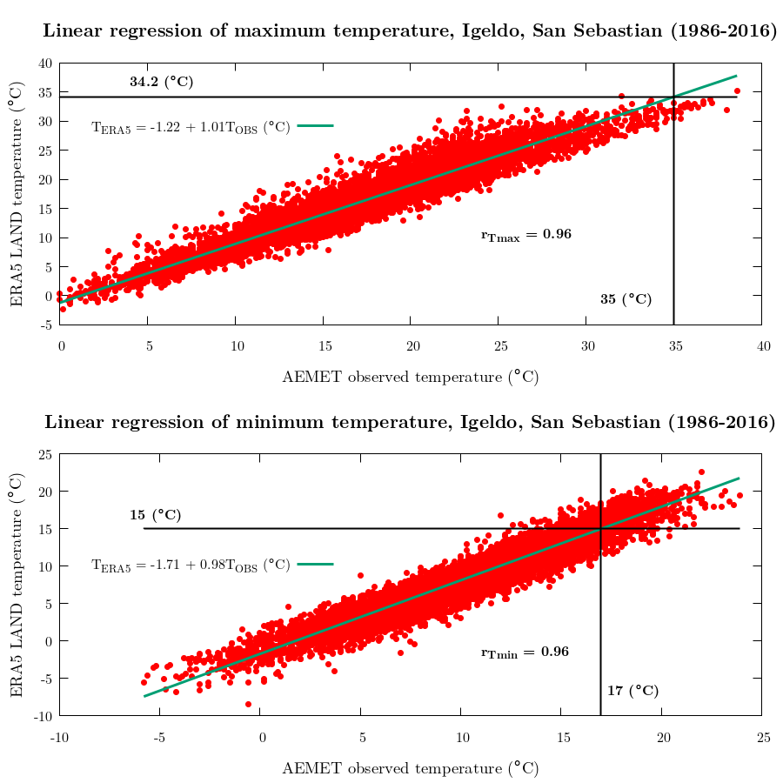
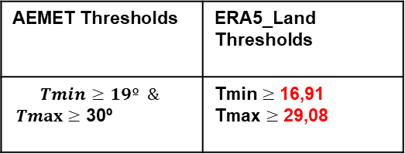
COASTAL ZONE
Igeldo-San Sebastian
AEMET Thresholds | ERA5_Land Thresholds
$$Tmin≥19º \&$$ $Tmax≥$ 30º | Tmin $≥$ 16,91 Tmax $≥$ 29,08

Slide 4
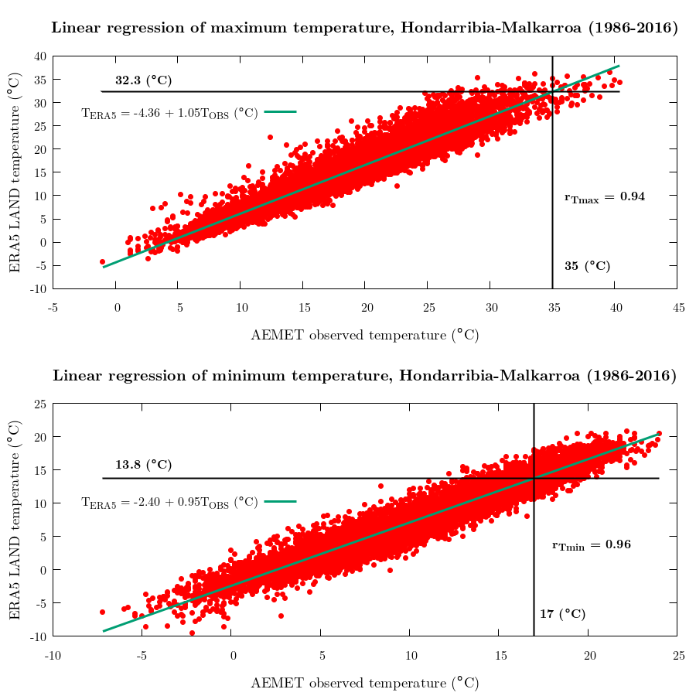
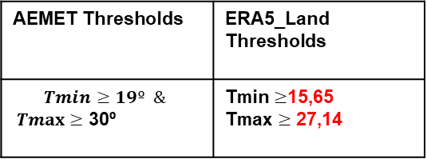
COASTAL ZONE
Hondarribia
AEMET Thresholds | ERA5_Land Thresholds
$$Tmin≥19º \&$$ $Tmax≥$ 30º | Tmin $≥$15,65 Tmax $≥$ 27,14

Slide 5
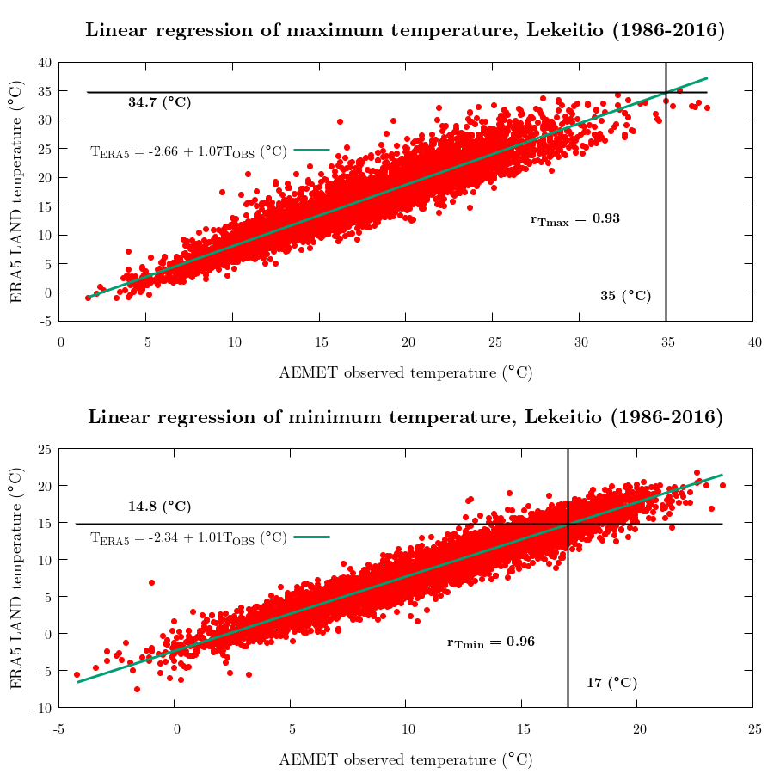
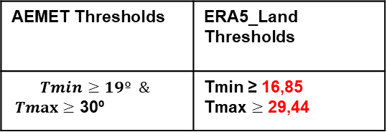
COASTAL ZONE
Lekeitio
AEMET Thresholds | ERA5_Land Thresholds
$$Tmin≥19º \&$$ $Tmax≥$ 30º | Tmin ≥ 16,85 Tmax $≥$ 29,44

Slide 6
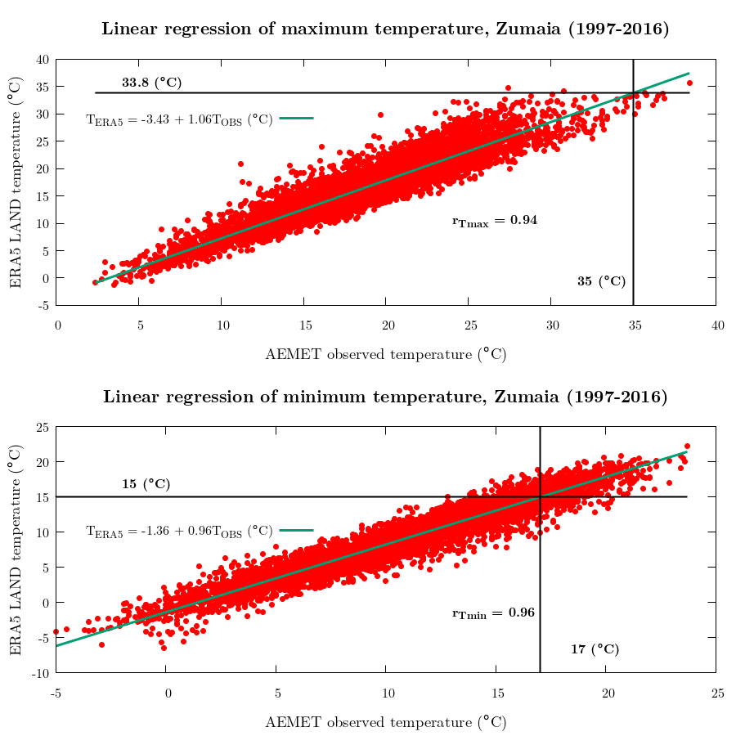
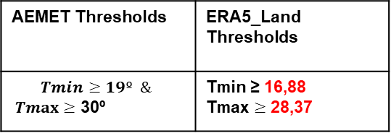
COASTAL AREA
Zumaia
AEMET Thresholds | ERA5_Land Thresholds
$$Tmin≥19º \&$$ $Tmax≥$ 30º | Tmin ≥ 16,88 Tmax $≥$ 28,37

Slide 7
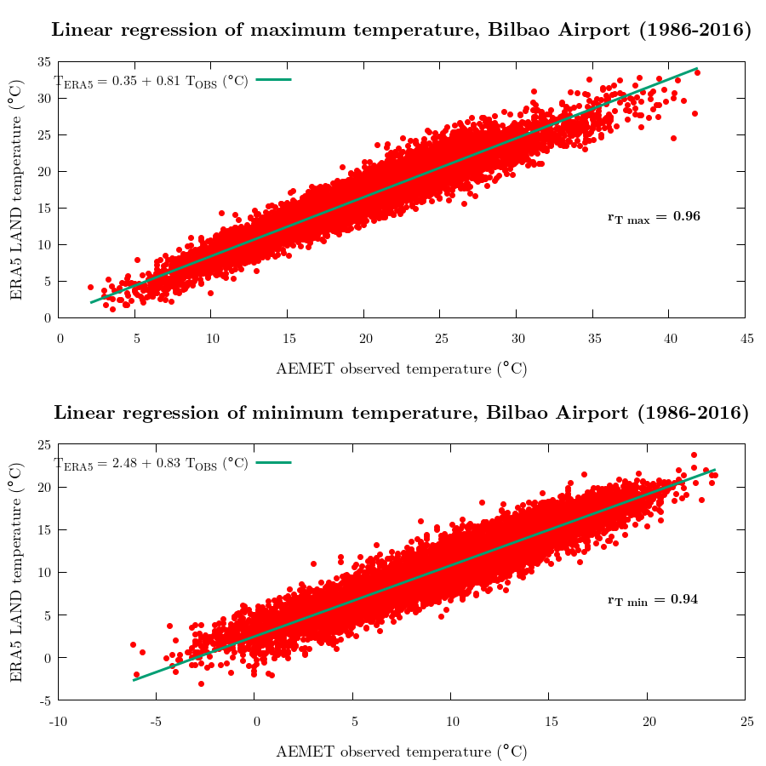
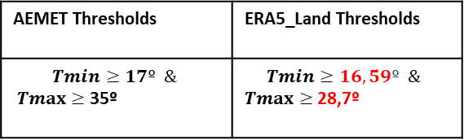
INLAND ZONE
Bilbao-Aeropuerto
28,7º
AEMET Thresholds | ERA5_Land Thresholds
$$Tmin≥17º \&$$ $Tmax≥$ 35º | $$Tmin≥16,59º \&$$ $Tmax≥$ 28,7º
16,59º
17º

Slide 8
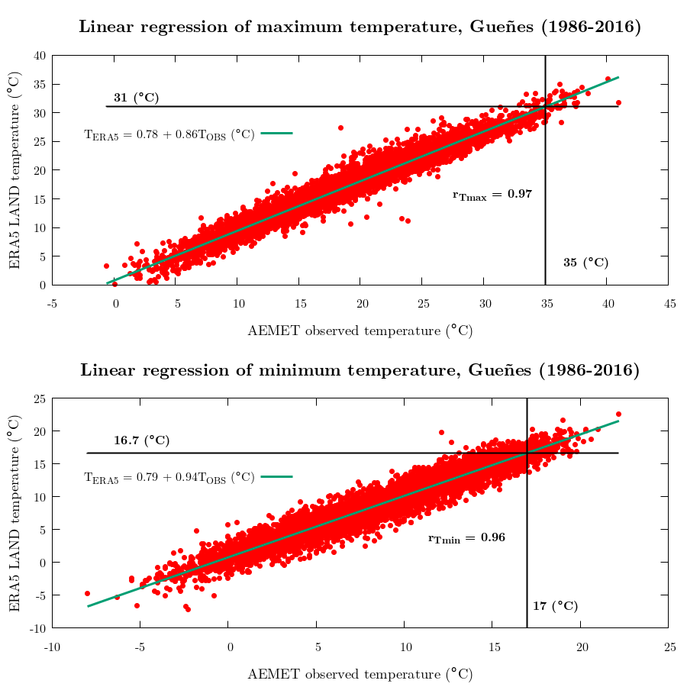
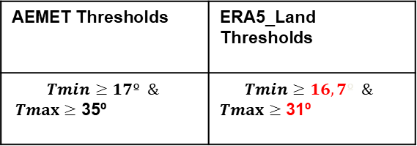
INLAND ZONE
Gueñes
AEMET Thresholds | ERA5_Land Thresholds
$$Tmin≥17º \&$$ $Tmax≥$ 35º | $$Tmin≥16,7º \&$$ $Tmax≥$ 31º

Slide 9
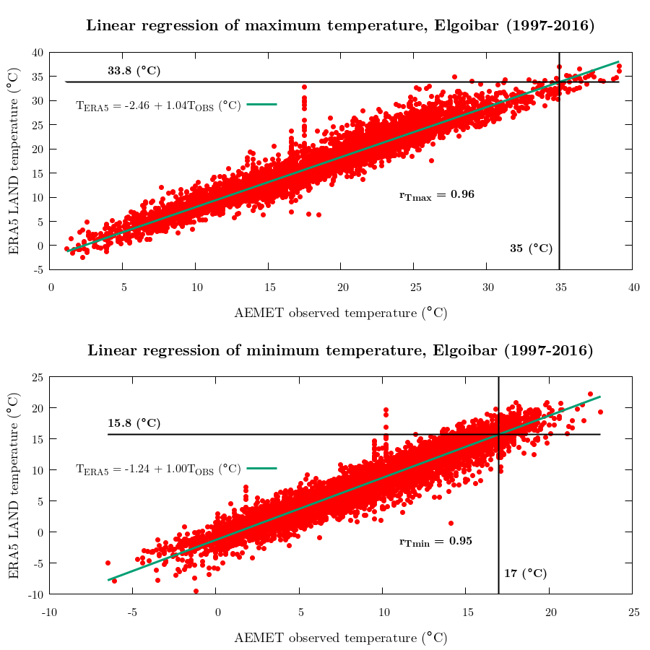
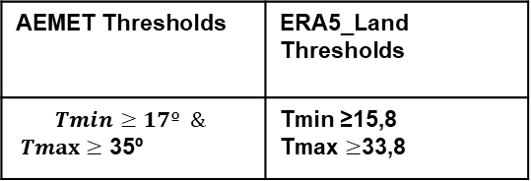
INLAND ZONE
Elgoibar
AEMET Thresholds | ERA5_Land Thresholds
$$Tmin≥17º \&$$ $Tmax≥$ 35º | Tmin ≥15,8 Tmax $≥$33,8

Slide 10
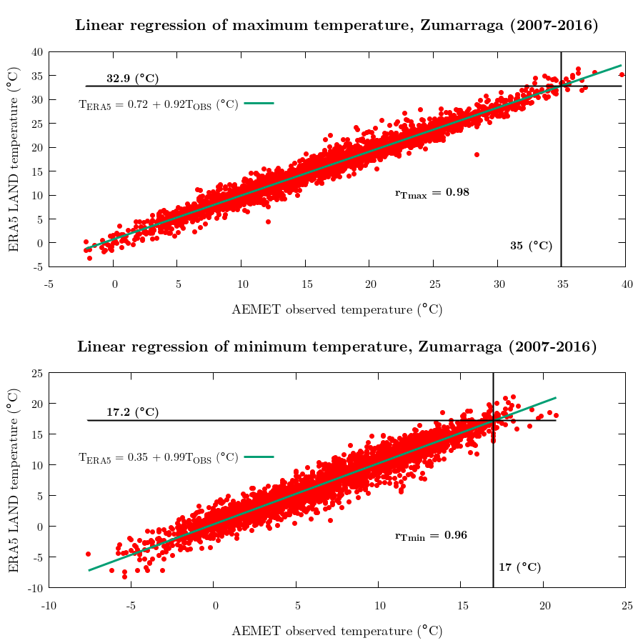
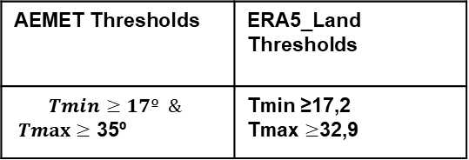
INLAND ZONE
Zumarraga
AEMET Thresholds | ERA5_Land Thresholds
$$Tmin≥17º \&$$ $Tmax≥$ 35º | Tmin ≥17,2 Tmax $≥$32,9

Slide 11
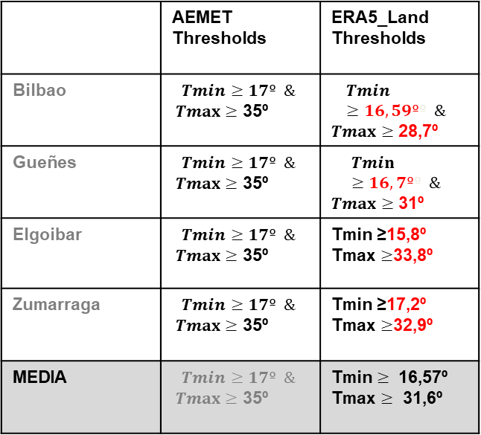
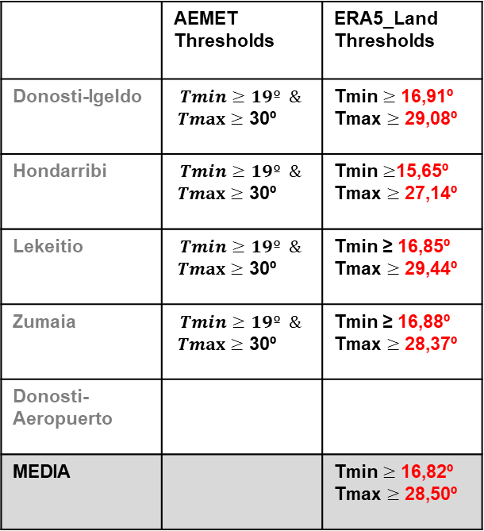
Observations versus ERA5-Land
Coastal Zone:
Interior Zone:
 | AEMET Thresholds | ERA5_Land Thresholds
Donosti-Igeldo | $$Tmin≥19º \&$$ $Tmax≥$ 30º | Tmin $≥$ 16,91º Tmax $≥$ 29,08º
Hondarribi | $$Tmin≥19º \&$$ $Tmax≥$ 30º | Tmin $≥$15,65º Tmax $≥$ 27,14º
Lekeitio | $$Tmin≥19º \&$$ $Tmax≥$ 30º | Tmin ≥ 16,85º Tmax $≥$ 29,44º
Zumaia | $$Tmin≥19º \&$$ $Tmax≥$ 30º | Tmin ≥ 16,88º Tmax $≥$ 28,37º
Donosti-Aeropuerto
MEDIA |  | Tmin $≥$ 16,82º Tmax $≥$ 28,50º
 | AEMET Thresholds | ERA5_Land Thresholds
Bilbao | $$Tmin≥17º \&$$ $Tmax≥$ 35º | $$Tmin≥16,59ºº \&$$ $Tmax≥$ 28,7º
Gueñes | $$Tmin≥17º \&$$ $Tmax≥$ 35º | $$Tmin≥16,7ºº \&$$ $Tmax≥$ 31º
Elgoibar | $$Tmin≥17º \&$$ $Tmax≥$ 35º | Tmin ≥15,8º Tmax $≥$33,8º
Zumarraga | $$Tmin≥17º \&$$ $Tmax≥$ 35º | Tmin ≥17,2º Tmax $≥$32,9º
MEDIA | $$Tmin≥17º \&$$ $Tmax≥$ 35º | Tmin $≥$ 16,57º Tmax $≥$ 31,6º

